Slide 1
From Propaganda to “Limited Effects”
Justin Murphy, PhD
University of Southampton
Jmrphy.net
@jmrphy

Slide 2
Conventional Wisdom, 1920s – 1950s
Much debate about whether mass media were a sinister or democratic emergence, but many influential media thinkers agreed mass media have powerful effects in shaping public opinion.
- Bernays (1891 − 1995)
- Lippmann (1889 – 1974)
- Wiener (1894 – 1964)
- McLuhan (1911 – 1980)
- Deutsche (1912–1992)
- Others

Slide 3
New Kids on the Block (1940s)
1. The Bureau of Applied Social Research at Colombia University (1944) pioneered the use of survey research and quantitative methods for the study of mass communications.
- AKA the “Colombia School”
- Led by Paul Lazarsfeld (1901-1976)
- Built on corporate, as well as state, funding
2. Specifically interested in the question of whether individual decision-making can be influenced by short-term media campaigns.
- Eerie County Study
- Decatur Study
- Elmira Study

Slide 4
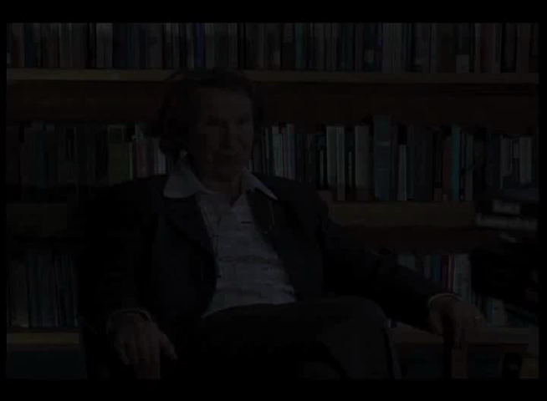
http://www.youtube.com/watch?v=bBeieGouXbQ

Slide 5
Limited Effects
Media rarely is a direct, necessary and sufficient cause of any opinion change.
When media does have an effect, it is highly conditional on the person’s “primary group.”
Though media does appear to have a robust effect in reinforcing previously held opinions.

Slide 6
Issues and Questions…

